Slide 1
Introduction to Microservices
Lecturer: Ngo Huy Bien
Software Engineering Department
Faculty of Information Technology
VNUHCM - University of Science
Ho Chi Minh City, Vietnam
nhbien@fit.hcmus.edu.vn

Slide 2

Objectives
To decide whether to apply micorservice architecture to develop a software system.

Slide 3

Contents
Terminologies
Monolithic Architecture
Service-Oriented Architecture
Microservices

Slide 4

References
https://martinfowler.com/articles/microservices.html
Cloves Carneiro and Tim Schmelmer (2016). Microservices From Day One. Apress.
Sam Newman (2021). Building Microservices - Designing Fine-Grained Systems. O'Reilly.

Slide 5
Terminologies (I) [1, 2]
We define libraries as components that are linked into a program and called using in-memory function calls, while services are out-of-process components who communicate with a mechanism such as a web service request, or remote procedure call.
A component (module) is a unit of software that is independently replaceable and upgradeable.
What is a service?
“a system supplying a public need.”
a service consists of a piece of functionality and its associated set of data.

Slide 6
Terminologies (II)
Service-oriented architecture
an architectural principle in which there is a bias to build systems through separately implemented, deployed, evolving, and maintained services.
In a set-up like that, any client-facing “front-end” applications then solely rely on a set of (back-end) services which expose the functionalities that the front-end applications consume in order to do their jobs.

Slide 7
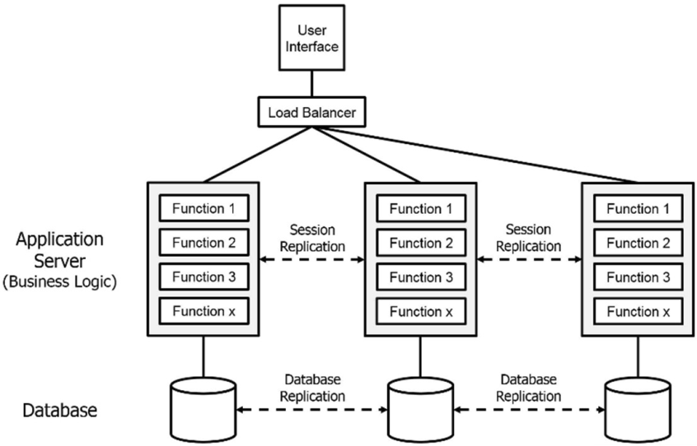
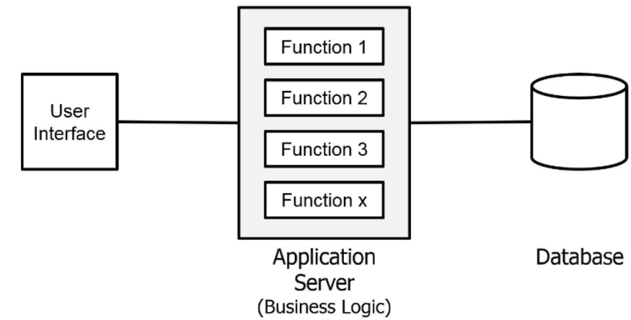
Monolithic Architecture
A monolith – a single logical executable.
At run time, all components will come together and run as one “process”.
Technology dependency.
Deployment dependency.
Features availability dependency.
Large codebase (slow build, large team, complex design).
Difficult horizontal scaling.

Slide 8
Why Not Use Shared Libraries? [3]
The library typically has to be in the same language, or at the very least run on the same platform.
The ease with which you can scale parts of your system independently from each other is curtailed.
Unless you’re using dynamically linked libraries, you cannot deploy a new library without redeploying the entire process, so your ability to deploy changes in isolation is reduced.

Slide 9
Why Not Use Modules?
We are strictly limited in our ability to use new technologies, limited in how we can scale independently, can drift toward integration techniques that are overly coupling, and lack seams for architectural safety measures.
Technically, it should be possible to create well-factored, independent modules within a single monolithic process. And yet we rarely see this happen.
The modules themselves soon become tightly coupled with the rest of the code, surrendering one of their key benefits.

Slide 10
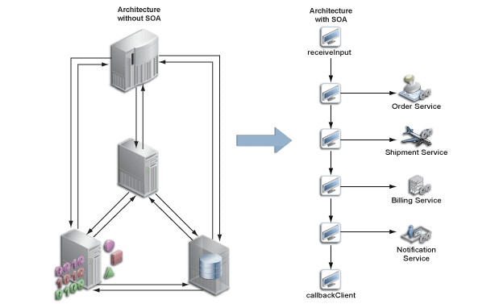
Service-Oriented Architecture
At run time, each component (“service”) will run as a separated “process”.
Communication between these services occurs via calls across a network rather than method calls within a process boundary.

Slide 11
Traditional SOA [2]
A set of medium-size to large monolithic applications, stitched together via expensive, and often complex, enterprise service bus (ESB) solutions.
Traditional SOAs advocate distributed objects.
The idea of distributed objects, which was very popular during the time when SOAs were first developed, is to try to hide the difference between objects that live in the same process as the client code, or remotely in a different process— whether that is running on the same CPU or on an altogether separate machine.
This often led to much more tightly coupled systems, where many of the inter-application contracts were not explicit, but rather implicit and hidden inside the ESB “glue layer.”

Slide 12
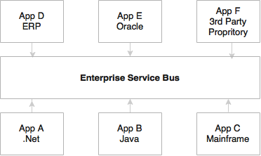
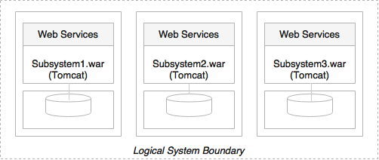
Traditional SOA Example [3]

Slide 13
Fine-Grained Calls Issue
CORBA and similar RMI technologies tried hard to enable client applications to allow for very fine-grained calls.
This leads to performance issue due to the impact of the unavoidable latency introduced by out-of-process and HTTP calls.

Slide 14
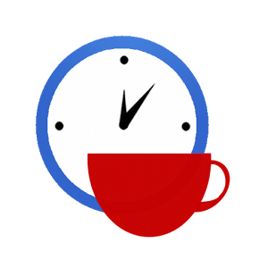

Slide 15
What are Microservices [1]
an architectural style that
"… is an approach to developing a single application as a suite of small services, each running in its own process and communicating with lightweight mechanisms, often an HTTP resource API.
These services are built around business capabilities and independently deployable by fully automated deployment machinery.
There is a bare minimum of centralized management of these services, which may be written in different programming languages and use different data storage technologies."

Slide 16
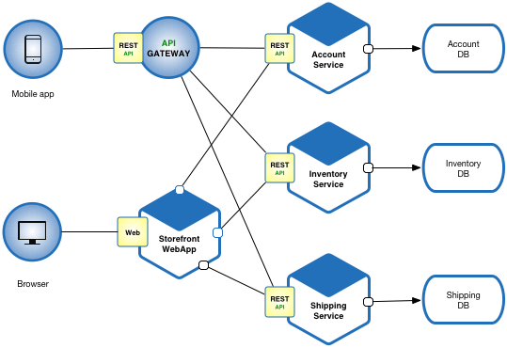
What are Services?
Services are small, independent units with their own persistent stores.

Slide 17
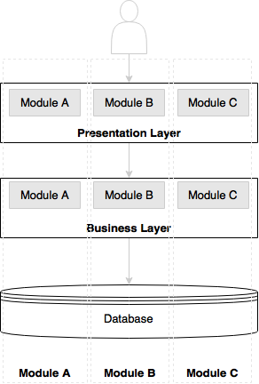
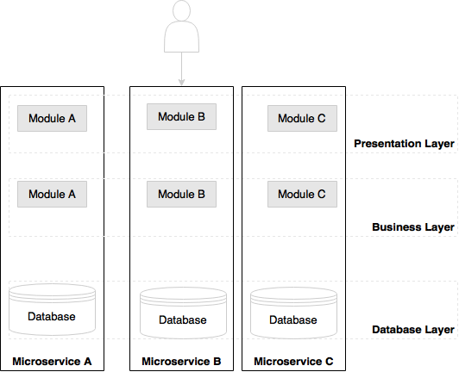
Application: A Suite of Services [3]
The divide-and-conquer technique to functionally partition monolithic applications into smaller atomic units, each performing a single function.

Slide 18
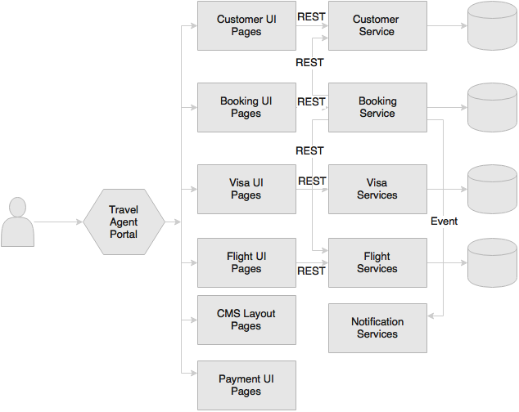
Microservices Example

Slide 19
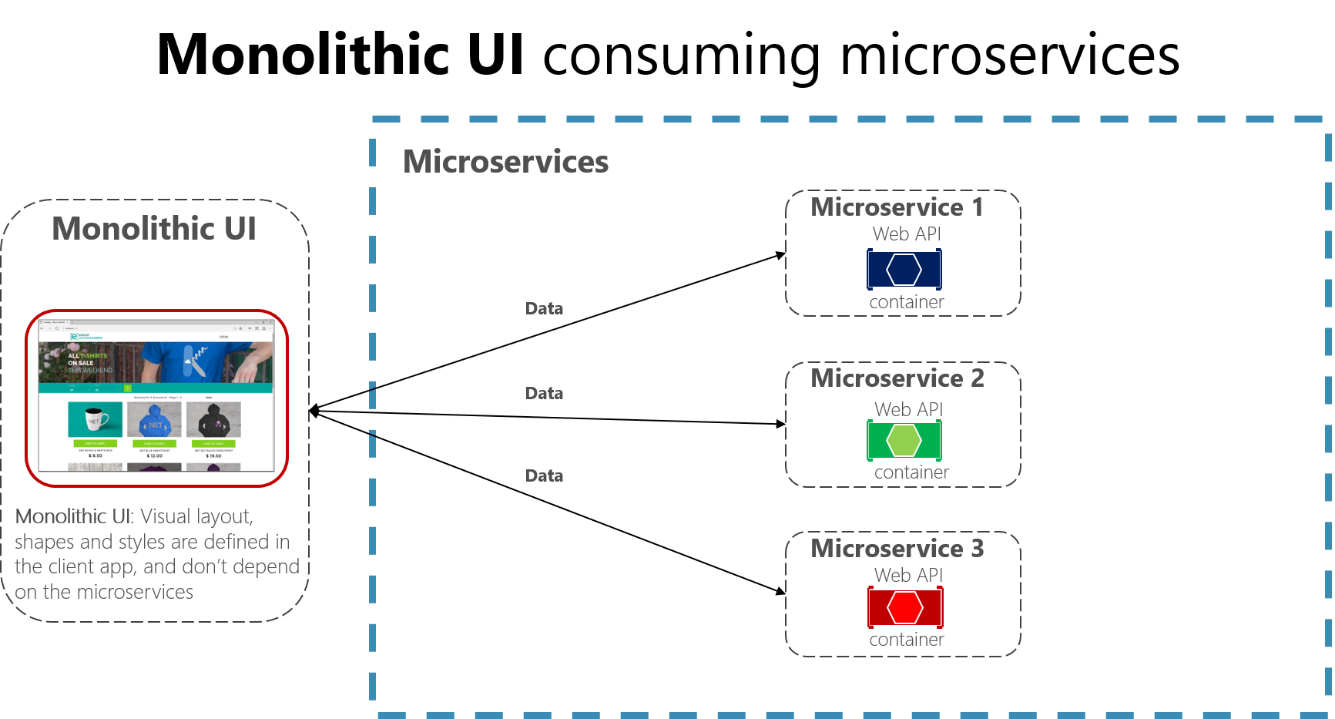
Monolithic UI with Microservices

Slide 20
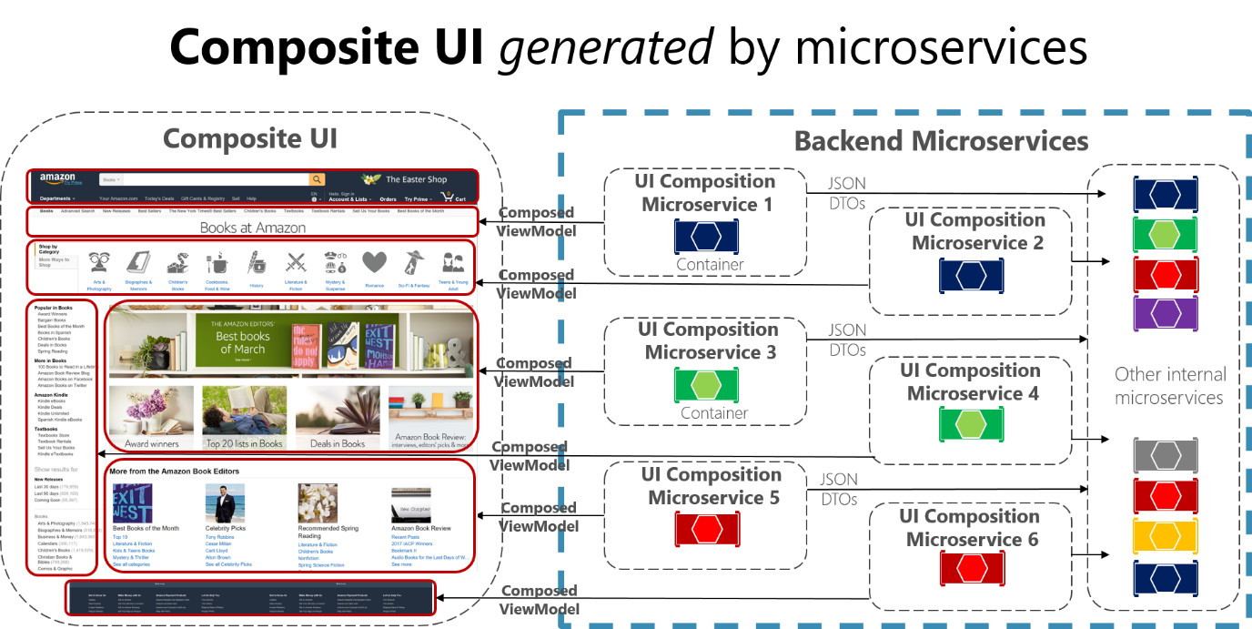
Composite UI with Microservices

Slide 21
Monolith vs. Microservices: Key Architectural Differences
Multiple back-end processes.
Multiple separate databases.
Independent deployment of back-ends and databases.
One front-end. (Possible multiple micro-frontends.)
Possible API gateways.

Slide 23
Microservices Origin
Domain-driven design. Continuous delivery. On-demand virtualization. Infrastructure automation. Small autonomous teams. Systems at scale.
Microservices have emerged from this world.
They weren’t invented or described before the fact; they emerged as a trend, or a pattern, from real-world use.

Slide 24
Why Microservices?
https://martinfowler.com/articles/microservice-trade-offs.html
Strong Module Boundaries: Microservices reinforce modular structure, which is particularly important for larger teams.
Independent Deployment: Simple services are easier to deploy, and since they are autonomous, are less likely to cause system failures when they go wrong.
Technology Diversity: With microservices you can mix multiple languages, development frameworks and data-storage technologies.

Slide 25

Why Microservices? (My Opinion)
Reason 1: You want to have several independent development teams.
Reason 2: You want or your client wants to have a faster and modern UI (i.e. SPA) that is totally decoupled from the other parts of the system.
Reason 3: You want or your client wants that a part of your system (e.g. user store and authentication) can be shared among or reused by multiple different systems.
Reason 4: You want or your client wants your system to be able to scale out easily later.
Reason 5: You want or your client wants that some parts of your system can be revised or extended or replaced easily later.

Slide 26
Microservice Costs
Operational Complexity: You need a mature operations team to manage lots of services, which are being redeployed regularly.
Distribution: Distributed systems are harder to program, since remote calls are slow and are always at risk of failure.
Eventual Consistency: Maintaining strong consistency is extremely difficult for a distributed system, which means everyone has to manage eventual consistency.

Slide 27
When to Use Microservices
https://martinfowler.com/bliki/MicroservicePremium.html
Is a microservice architecture a good choice for the system you're working on?
don't even consider microservices unless you have a system that's too complex to manage as a monolith.
https://martinfowler.com/bliki/MonolithFirst.html
The complexity that drives us to microservices can come from many sources including dealing with large teams, multi-tenancy, supporting many user interaction models, allowing different business functions to evolve independently, and scaling.
But the biggest factor is that of sheer size - people finding they have a monolith that's too big to modify and deploy.

Slide 28
When Not to Use Microservices
https://martinfowler.com/bliki/MicroservicePremium.html
The microservices approach is all about handling a complex system, but in order to do so the approach introduces its own set of complexities.
When you use microservices you have to work on automated deployment, monitoring, dealing with failure, eventual consistency, and other factors that a distributed system introduces. There are well-known ways to cope with all this, but it's extra effort.
https://martinfowler.com/bliki/MonolithFirst.html
The first reason for this is classic Yagni.
The second issue with starting with microservices is that they only work well if you come up with good, stable boundaries between the services.
Any refactoring of functionality between services is much harder than it is in a monolith. But even experienced architects working in familiar domains have great difficulty getting boundaries right at the beginning.

Slide 30
Why Microservices: Example
http://philcalcado.com/2015/09/08/how_we_ended_up_with_microservices.html
If you were to ask anybody from any of the teams about how our development process worked, they would describe something like this:
Somebody has an idea for a feature, they write a couple of paragraphs and draw some mockups. We then discuss it as a team.
Designers shape up the user experience.
We write the code.
After a little testing, we deploy.

Slide 31
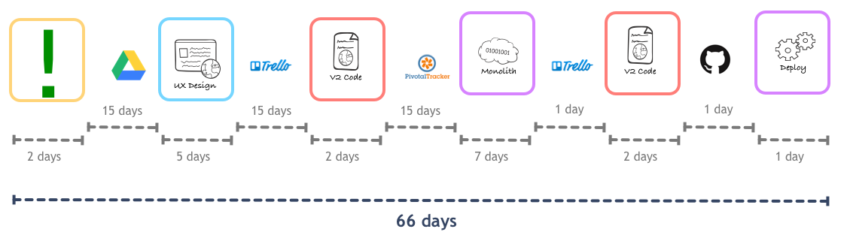
Value Stream Map
The actual flow was something like this:
Somebody comes up with an idea for a feature. They then write a fairly lightweight spec, with some screen mockups, and stores that in a Google Drive document.
The spec stays in this document until somebody has time to actually work on it.
...

Slide 32
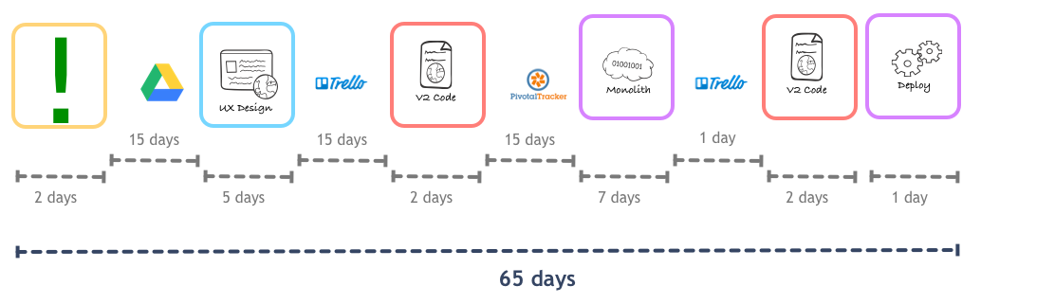
Adopt a Release Train
Adopt a release train for the monolith.
Instead of waiting until we had enough features for a deploy, we would start deploying every day, just after standup, irrespective of how many features had landed into master.
This was still far away from Continuous Deployment, but trimmed our cycle a little bit:

Slide 33
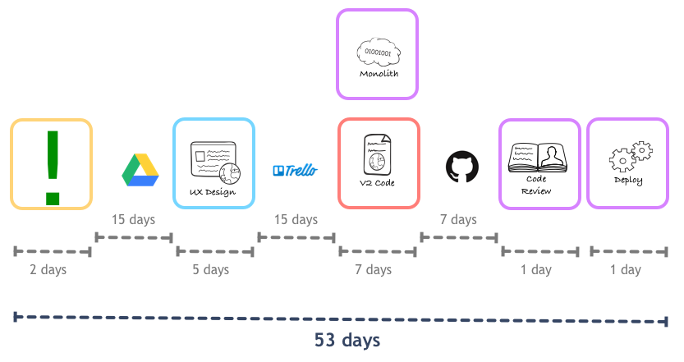
Implementation
Pair back-end and front-end developers and make this pair be fully dedicated to a feature until its completion.

Slide 34
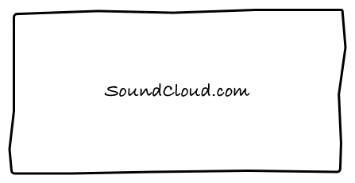
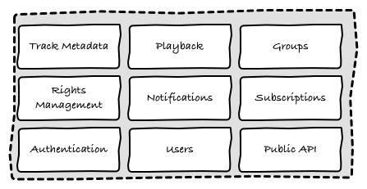
The Monolith

Slide 35
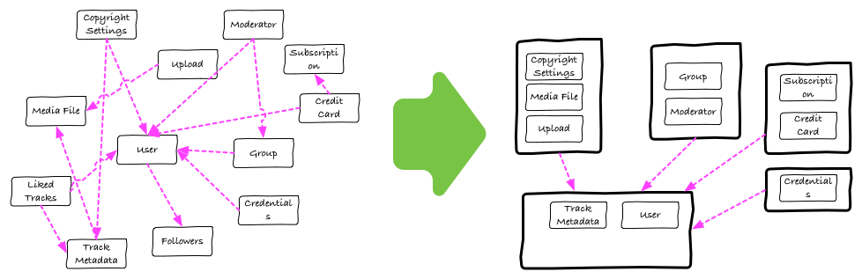
Break a Monolith into Microservices (I)
Breaking a monolith to microservices (a change made for a single feature could be developed in relative isolation).

Slide 36
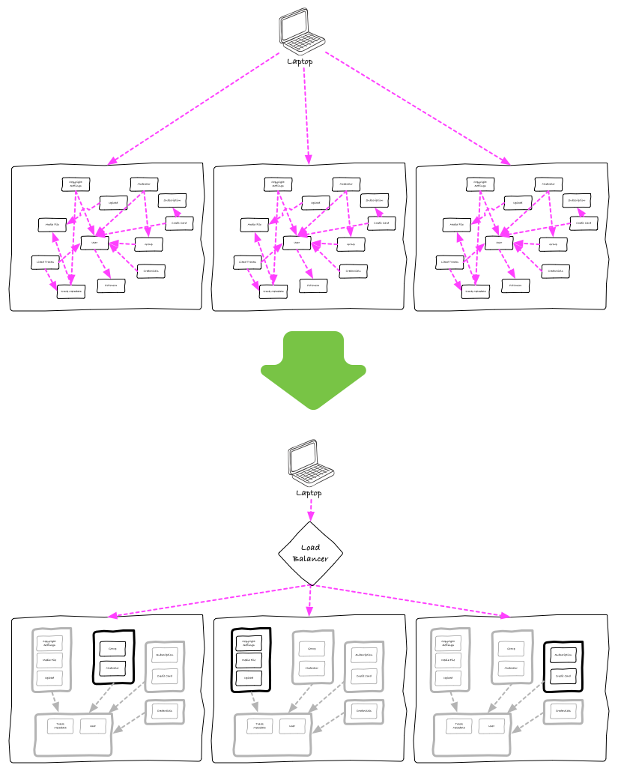
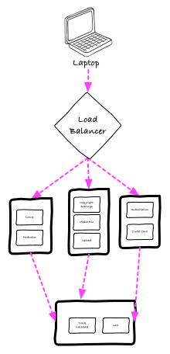
Break a Monolith into Microservices (II)

Slide 37
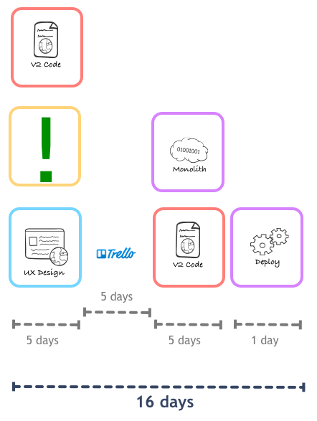
Lead Time for New Features

Slide 39
DeathStarBench
Yu Gan et al. (2019). An Open-Source Benchmark Suite for Microservices and Their Hardware-Software Implications for Cloud & Edge Systems.
https://github.com/delimitrou/DeathStarBench
Social Network: C++, Apache Thrift RPC, Lua/OpenResty frontend, MongoDB, Redis, Memcached, RabbitMQ, Docker Compose, Docker Swarm, Jaeger, Python init scripts.
Hotel Reservation: Go, gRPC, MongoDB, Memcached, Docker, Kubernetes, OpenShift, Helm, Consul, OpenTracing, Jaeger.

Slide 40
Online Boutique
https://github.com/googlecloudplatform/microservices-demo
Go, Python, C#, Node.js, gRPC, Docker, Kubernetes, Skaffold, Kustomize, Helm, Terraform, GKE, Istio, and Redis.
https://github.com/GoogleCloudPlatform/microservices-demo/blob/main/docs/development-guide.md
git clone https://github.com/GoogleCloudPlatform/microservices-demo
cd microservices-demo/
Start Docker.
minikube start --cpus=4 --memory 4096 --disk-size 32g
kubectl get nodes
skaffold run # https://skaffold.dev/docs/references/cli/
kubectl port-forward --address 0.0.0.0 deploy/frontend 8080:8080

Slide 41
Bookinfo
https://istio.io/latest/docs/examples/bookinfo/
Python, Ruby, Java.
Node.js.
Kubernetes and Istio.
https://istio.io/latest/docs/setup/getting-started/

Slide 42
TeaStore
(2018). TeaStore.
https://github.com/descartesresearch/teastore
Java, Maven, Netflix Ribbon, MariaDB.
Docker, Docker Compose, Kubernetes, Helm, Kieker, OpenTracing, Istio, RabbitMQ, LIMBO.
JMeter and Locust.

Slide 43
JPetStore and PetClinic
https://github.com/mybatis/jpetstore-6
A Java, Maven, WAR-based monolithic web application using MyBatis 3, Spring, Stripes, JSP, HSQLDB, SQL, XML configuration, Docker, Docker Compose, and GitHub Actions.
https://github.com/spring-petclinic/spring-petclinic-microservices
Java Spring Boot, Spring Cloud Gateway, Eureka, Spring Cloud Config, Resilience4j, Micrometer, OpenTelemetry, Zipkin, Prometheus, Grafana, AngularJS, HSQLDB/MySQL, Maven, Docker/Podman, Docker Compose, and JMeter.

Slide 44
Sock Shop
https://github.com/ocp-power-demos/sock-shop-demo
Spring Boot, Go, Node.js, MongoDB, Docker, Kubernetes, OpenShift.

Slide 45
µBench
https://github.com/mSvcBench/muBench
A microservice benchmark factory: it generates configurable dummy microservice applications and deploys them on Kubernetes.

Slide 46

Thank You & See You Again

